Slide 1
Predictive and forecasting sales and inventory analytics with Turbodata
M & N Business Intelligence India LLP
President: Mr. Apoorv Chaturvedi: apoorv@mnnbi.com(Phone: 8802466356)
Ritu Lakhani: ritu@mnnbi.com
Anup Pandey: anup@mnnbi.com
Website: www.mnnbi.com
Phone: 0124-4365845

Slide 2
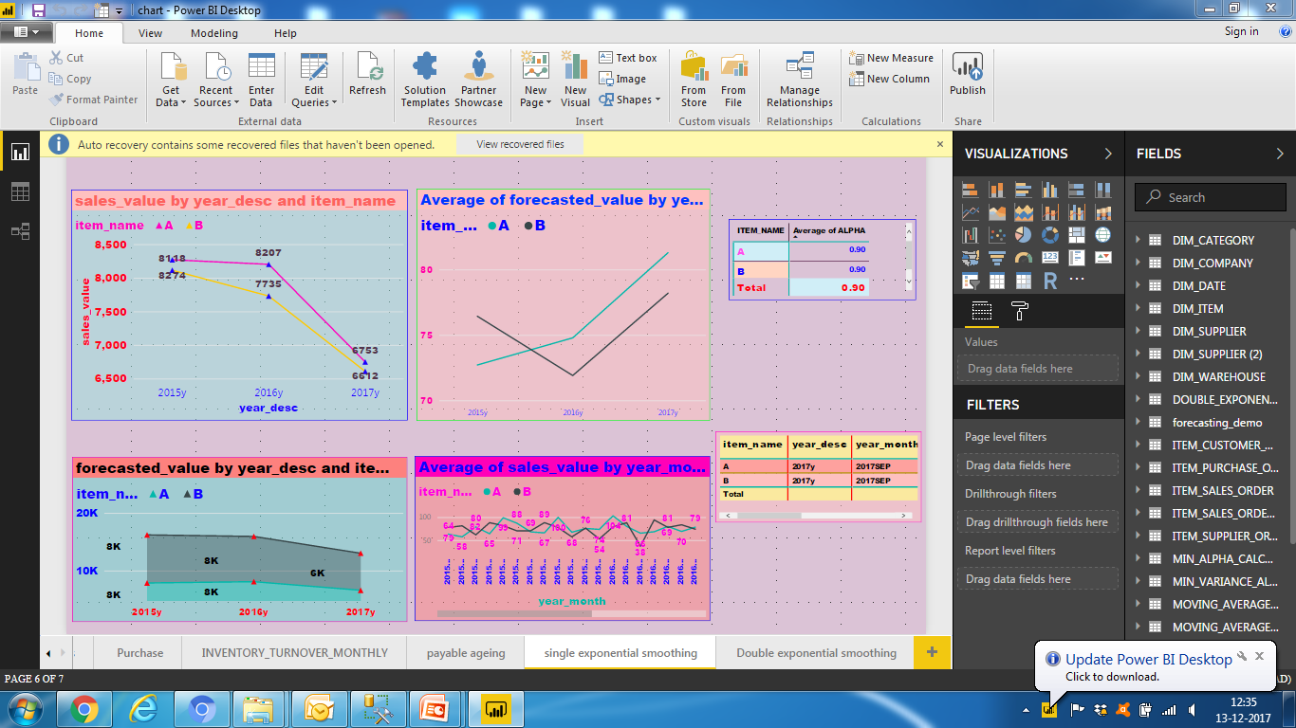
Free Microsoft Power BI below 1GB embedded with R
Data compression with Turbodata
Power BI Embedded with R

Slide 3
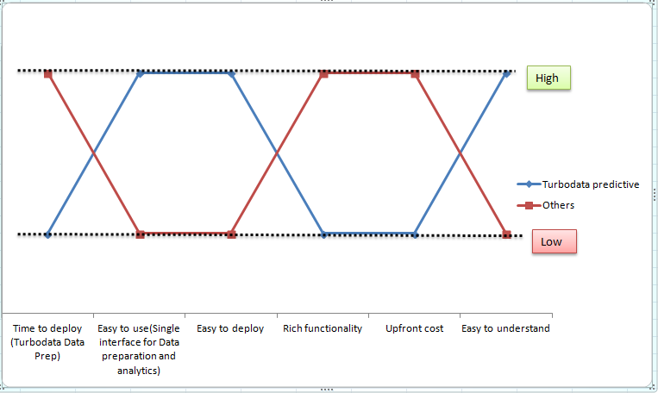
Strategy Map of Turbodata with Other Predictive Analytic Solutions

Slide 4
Value Proposition
Turbodata
Predictive and Forecasting
Eliminate: Cubes Joining large transaction tables Understanding the complexity of insurance ,sales and finance systems Complex manual spreadsheets Hanging of source systems while extraction of data | Raise: Ease of reporting Convenience: work with Microsoft stack of tools Ability to handle large loads Ease of deployment: Point and click deployment Number of concurrent users for reports Number of reports that could be reloaded in a nightly ETL load Source system Data audit quality
Reduce: Data extraction times Business Logic coding time Maintenance times BI Costs: Tool costs and implementation costs Length of sql code required to make reports Reporting Data Size ETL development costs and the cost of the ETL tools Report development times: Make highly complex reports quickly at the database level Data refresh times for reports | Create: Readymade ETL processes. Productize the reporting outputs. Aggregates for faster analysis
Eliminate: Complex SAS and ‘R’ coding Manual intervention for predictive analytics | Raise: Ease of understanding predictive and forecasting analytics
Reduce: Manpower resources for predictive analytics and forecasting Costs of the predictive analytics and forecasting solutions Hardware/software requirements for forecasting and predictive analytics | Create: Readymade custom sql code for predictive analytics over compressed datawarehouse of Turbodata Machine learning

Slide 5
What do we offer ?
Readymade extraction products to consolidate, compress data from multiple sources
Turbodata
Predictive and Forecasting
Higher inventory turnover ratio
Higher receivable turnover ratio
Higher payable turnover ratio(This is through ARIMA Analysis)
Lower Coding time
Faster Data Access
Easy to use application
Costs
Graphs
Dashboards
Consolidation of data from different data sources
On fly calculations like COGS at database level
Value
Combination of items/services been offered (This is through Market Basket analysis)

Slide 6
Pre Requisites from end client
Extraction of data into Turbodata:ETL team and end client
Predictive analytics work:ETL team
Analysis of PowerBI dashboards: Functional team and end client
Design of hypothesis-analysis of best practices in United States: functional team and end client

