Slide 1
Track the movement of Retail sales over periods in time
M & N Business Intelligence India LLP
President: Mr. Apoorv Chaturvedi: apoorv@mnnbi.com(Phone: 8802466356)
Ritu Lakhani: ritu@mnnbi.com
Anup Pandey: anup@mnnbi.com
Website: www.mnnbi.com
Phone: 0124-4365845

Slide 2
Requirements of CEO\CFO
S
P
P
D
Sustainability
Profitability
Predictability
De risking
Turbodata
Source: Better India, Better World: Narayana Murthy(Requirements from Leadership)

Slide 3
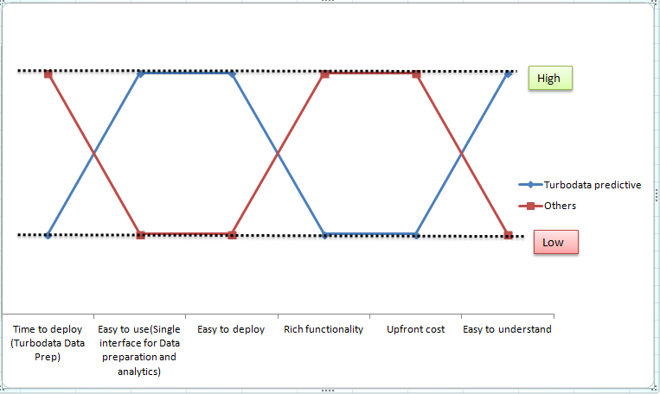
Strategy Map of Turbodata with Other Predictive Analytic Solutions
Courtesy: Blue Ocean Strategy

Slide 4
Value Proposition
Turbodata
Predictive and Forecasting
Eliminate: Cubes Joining large transaction tables Understanding the complexity of insurance systems Complex manual spreadsheets Hanging of source systems while extraction of data | Raise: Ease of reporting Convenience: work with Microsoft stack of tools Ability to handle large loads Ease of deployment: Point and click deployment Number of concurrent users for reports Number of reports that could be reloaded in a nightly ETL load Source system Data audit quality
Reduce: Data extraction times Business Logic coding time Maintenance times BI Costs: Tool costs and implementation costs Length of sql code required to make reports Reporting Data Size ETL development costs and the cost of the ETL tools Report development times: Make highly complex reports quickly at the database level Data refresh times for reports | Create: Readymade ETL processes. Productize the reporting outputs. Aggregates for faster analysis
Eliminate: Complex SAS and ‘R’ coding Manual intervention for predictive analytics | Raise: Ease of understanding predictive and forecasting analytics
Reduce: Manpower resources for predictive analytics and forecasting Costs of the predictive analytics and forecasting solutions Hardware/software requirements for forecasting and predictive analytics | Create: Readymade custom sql code for predictive analytics over compressed datawarehouse of Turbodata Machine learning
Courtesy: Blue Ocean Strategy

Slide 5
What do we offer ?
Readymade extraction products to consolidate, compress data from multiple sources
Turbodata
Predictive and Forecasting
Higher inventory turnover ratio
Higher receivable turnover ratio
Lower payable turnover ratio(This is through ARIMA Analysis)
Lower Coding time
Faster Data Access
Easy to use application
BI tool cost reduction
Costs
Graphs
Dashboards
Consolidation of data from different data sources
On fly calculations like COGS at database level
Value
Combination of items/services been offered (This is through Market Basket analysis)
Courtesy: Blue Ocean Strategy

Slide 6
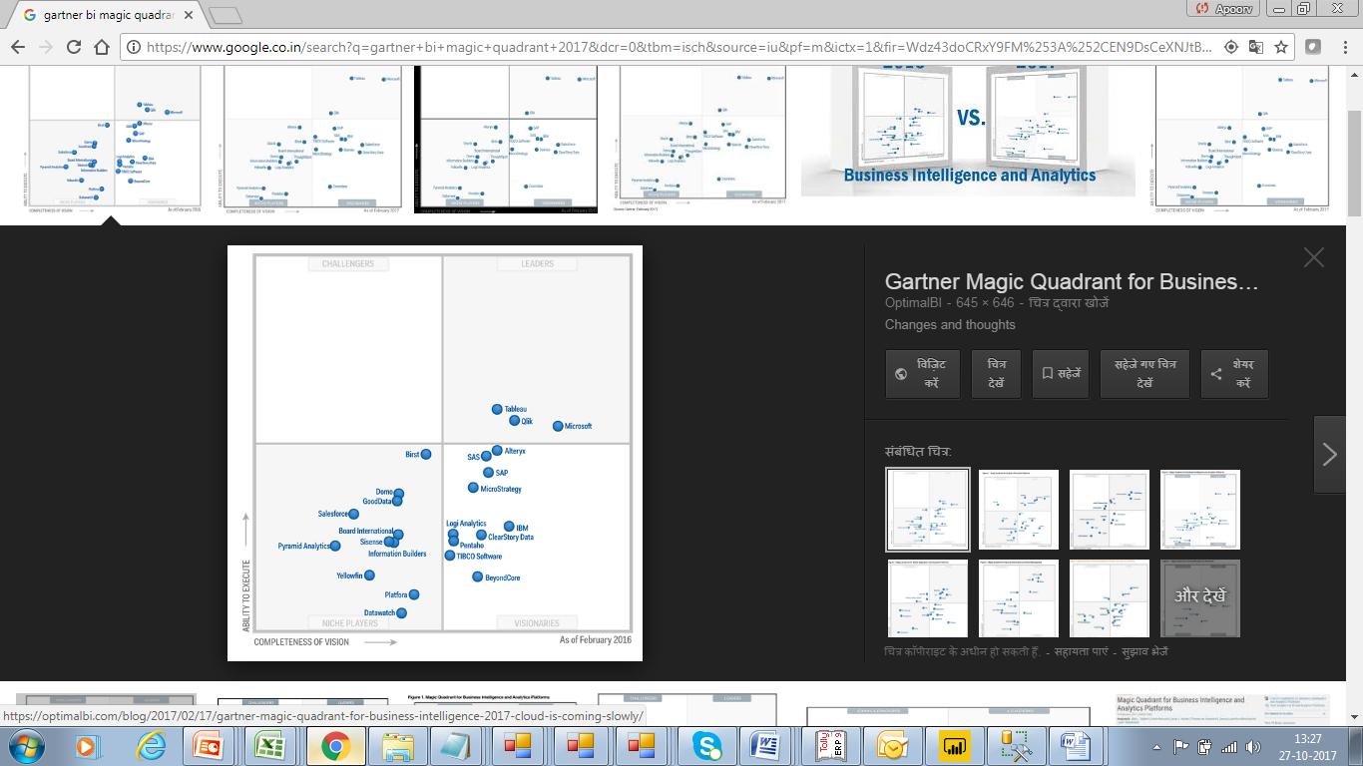
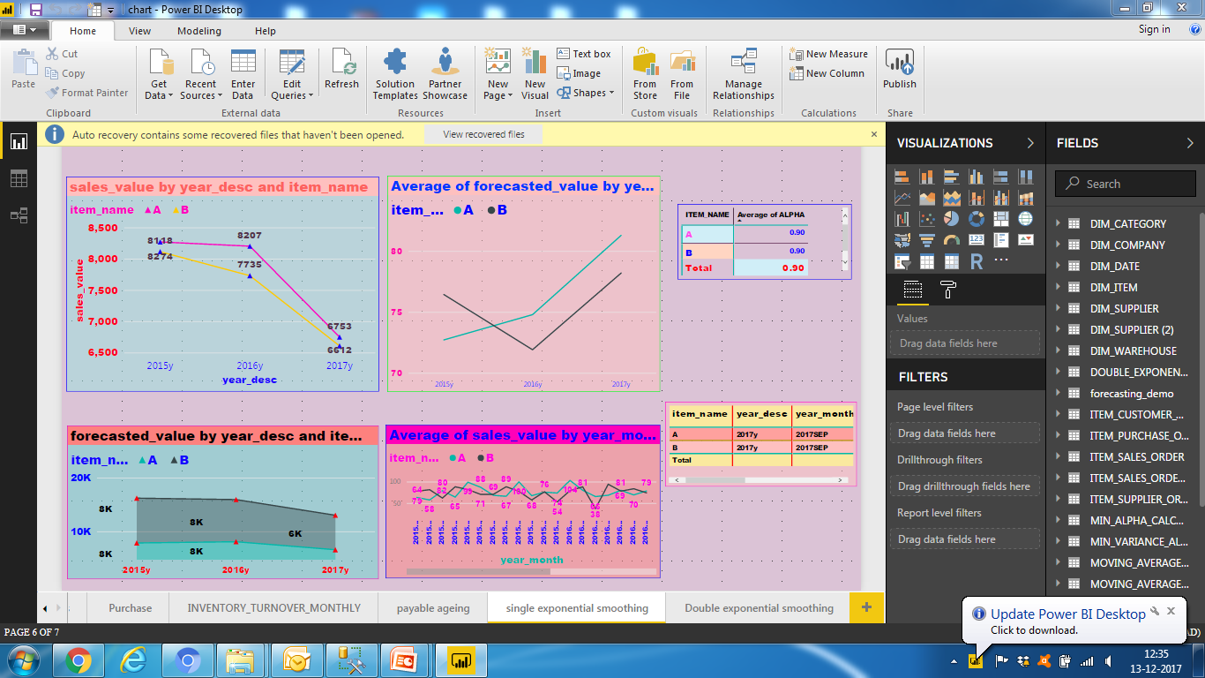
Free Microsoft Power BI below 1GB embedded with R
Power BI Embedded with R

Slide 7
Benefits Slide-Turbodata
 | Delivery | Deployment | Use | Maintenance | Additional supplements
Speed of reporting |  |  | √
Easy | √ | √ | √ |  | √
Convenience |  |  |  | √
Low risk-Usage and Sales |  |  | √
Lively and interactive presentation of information |  |  | √
Courtesy: Blue Ocean Strategy

Slide 8
Benefits- Turbodata Forecasting
 | Delivery | Deployment | Use | Maintenance | Additional Supplements
Speed of predic tive analy tics |  |  | √ (Compressed data of Turbodata enables highly complex forecasting modules to be run)
Easy |  |  | √(embedded within Turbodata. Automated process. Little/no manual intervention could be required) |  | √(SQL Server Express edition)
Convenience |  |  |  | √(Scenario testing and machine learning
Low risk-Usage and Sales |  |  | √(Numbers matching with Excel and actual data
Lively and interactive presentation of information(Microsoft Power BI) |  |  | √(Microsoft Power BI)
Courtesy: Blue Ocean Strategy

Slide 9
Benefits-Lower ETL Times
Source system update
Report delivery time
ETL time
Report Reload time
Report Reload time/Predictive analytics and forecasting
ETL time
Lower ETL time means higher predictive and forecasting times

Slide 10
Trends in Retail Industry
Demand of a particular product, brand, category, company.
Seasonal performance of products.
New trends with new arrivals.
Mark down and mark up with changing seasons and coming festivals.
Unseasonal demand of products: Noise.
Frequency of items bought with time.
Better management of warehouse.
Plan you stock inventories.
This list goes on and on!!

Slide 11
Hypothesis
Test of the following hypothesis:
  The growth of a particular set of the product of Retail company has been due to historical factors related with level, trend and seasonality-Growth is happening on its own
  Effective marketing strategy-the difference between the predicted and the actual sales numbers are statistically significant
Analysis based on Australian case study(link attached herewith)
https://www.researchgate.net/publication/228637692_A_Time-Series_Analysis_of_the_Demand_for_Life_Insurance_Companies_in_Australia_An_Unobserved_Components_Approach
Courtesy: McKinsey Way by Ethan Rusell

Slide 12
Basic forecasting model
Sales forecasting as per defined clusters: customer type, location, age, channel etc
Difference analysis: actual and predicted-look for statistically significant variations
Level
Trend
Seasonality analysis

Slide 13
Process flow chart
Time series analysis
Single exponential smoothing
Double exponential smoothing
Alpha is below .7
Is alpha above .7
Autoregressive analysis- up to 7 periods
Trend & Seasonality pattern –find s(t) and b(t) and error terms . Find the beta with the minimum variance of error.
Check if the error ACF follows a decaying pattern
Is autocorrelation function decaying exponentially with time: If no then go to double exponential smoothing
Autocorrelation function decaying exponentially then predict the forecasted value for next 3 time periods
If yes, then predict the forecast for next 3 months/quarters
If no then go to triple exponential smoothing
Find the cyclicity and seasonality
Triple exponential smoothing
Check for the error terms. Find the L at which the variance of the error is minimum
Find the total predicted sale value by summing the single, double and triple exponential smoothing results

Slide 14
Process flow chart
Double exponential smoothing
Alpha is below .7
Trend & Seasonality pattern –find s(t) and b(t) and error terms . Find the beta with the minimum variance of error.
Check if the error ACF follows a decaying pattern
If yes, then predict the forecast for next 3 months/quarters
If no then go to triple exponential smoothing
Find the cyclicity and seasonality
Triple exponential smoothing
Check for the error terms. Find the L at which the variance of the error is minimum
Find the total predicted sale value by summing the single, double and triple exponential smoothing results

Slide 15
Process flow chart
Time series analysis
Single exponential smoothing
Double exponential smoothing
Alpha is below .7
Is alpha above .7
Autoregressive analysis- up to 7 periods
Trend & Seasonality pattern –find s(t) and b(t) and error terms . Find the beta with the minimum variance of error.
Check if the error ACF follows a decaying pattern
Is autoregressive function decaying exponentially with time: If no then go to double exponential smoothing
Autoregressive function decaying exponentially then predict the forecasted value for next 3 time periods
If yes, then predict the forecast for next 3 quarters
If no then go to triple exponential smoothing
Find the cyclicity and seasonality
Triple exponential smoothing
Check for the error terms. Find the L at which the variance of the error is minimum
Find the total predicted sale value by summing the single, double and triple exponential smoothing results

Slide 16
Single Exponential Smoothing
F_{t+1}(t) = αA_{t} + α(1-α)A_{t-1} + α(1-α)²A_{t-2} + α(1-α)³A_{t-3} +…..
Large α adjusts more quickly to changes
Smaller α provides more “averaging” and thus lower variance when things are stable
Exponential smoothing is intuitively more appealing than moving averages

Slide 17
Exponential Smoothing Examples

Slide 18
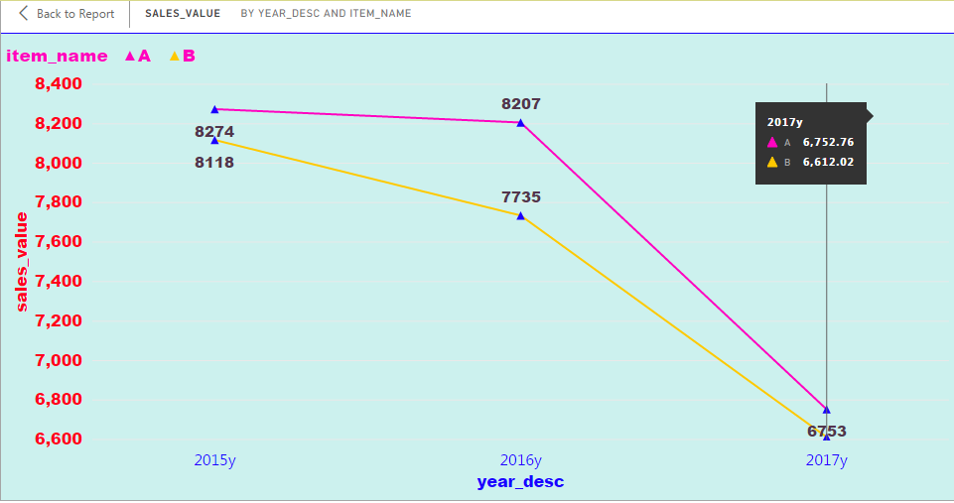
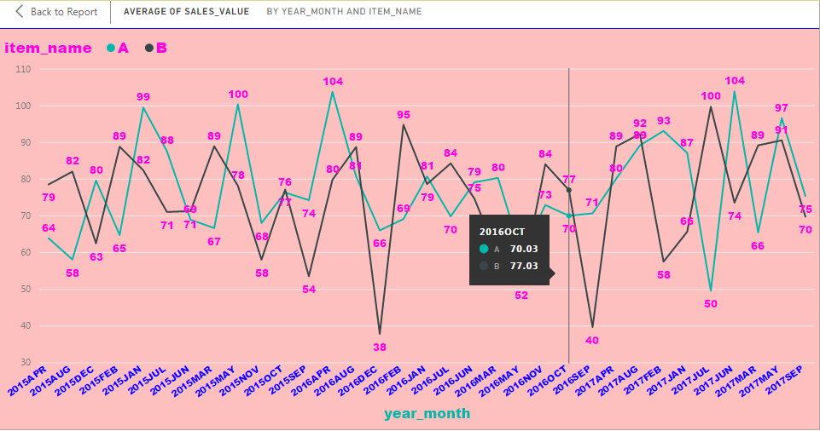

Slide 19
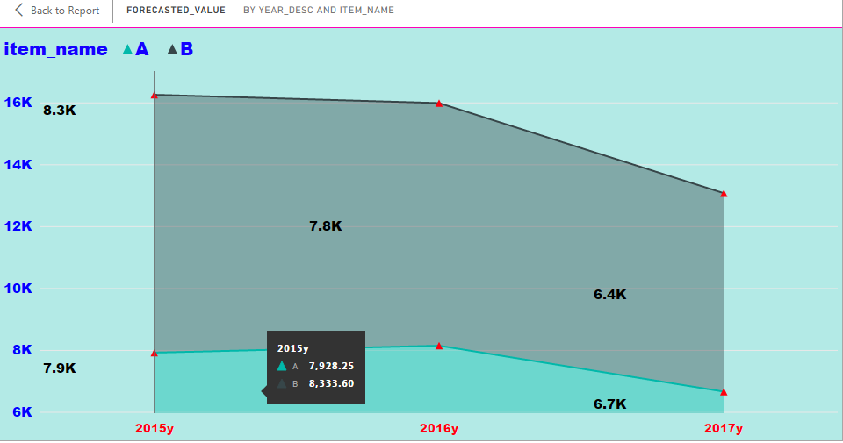

Slide 20
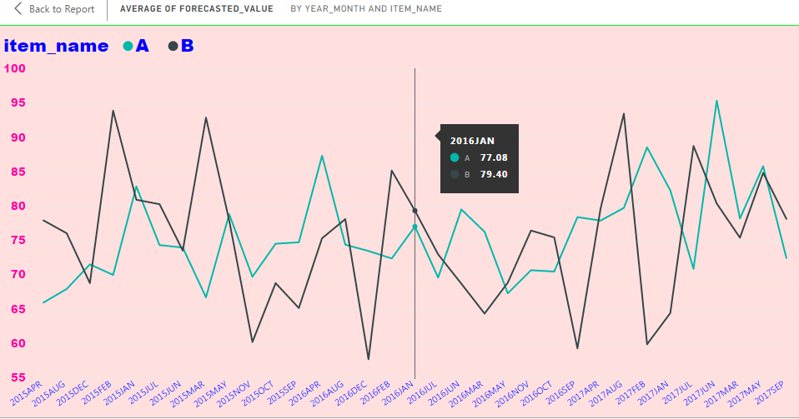
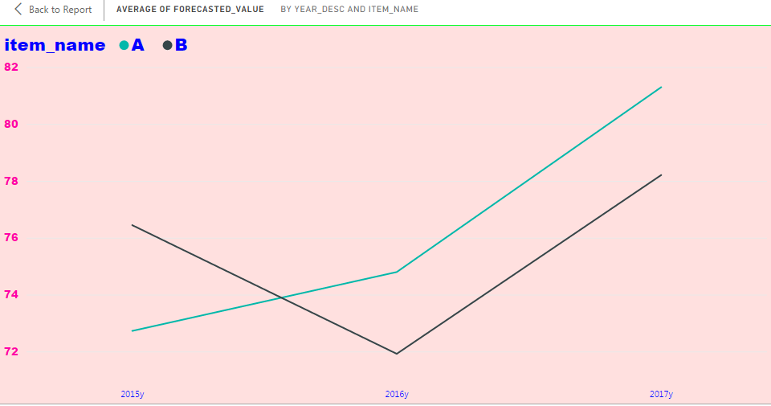

Slide 21
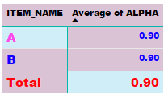
The latest values are having the maximum weightage in calculating the forecasted values

Slide 22
Double Exponential Smoothing Model
Ct= α Yt+ (1- α)(Ct-1+Tt-1)
Tt= β(Ct-Ct-1) + (1- β) Tt-1
Ft+1=Ct+Tt
yt = actual value in time t
α = constant-process smoothing constant
β = trend-smoothing constant
Ct = smoothed constant-process value for period t
Tt = smoothed trend value for period t
Ft+1= forecast value for period t + 1
t = current time period

Slide 23
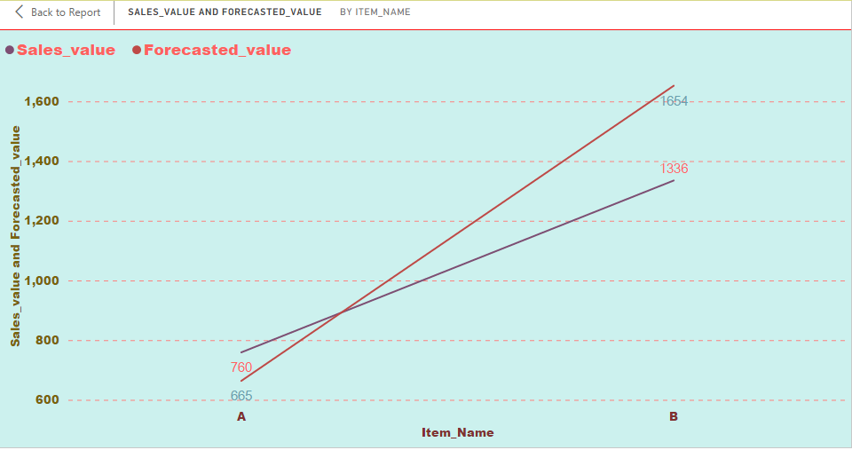
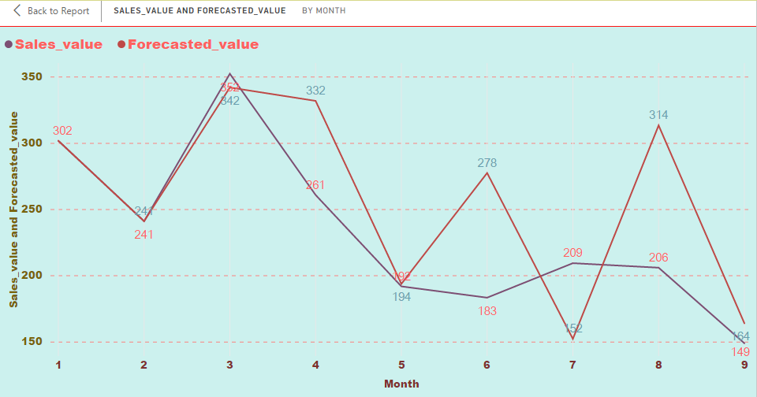

Slide 24
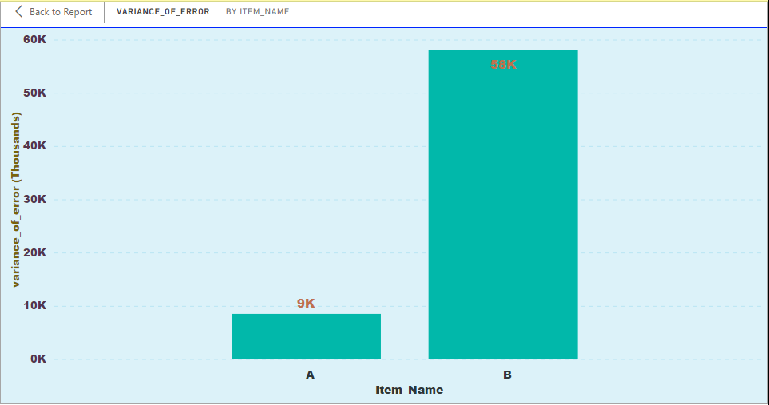
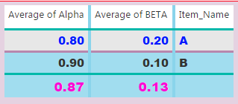
Combination of alpha and beta having the minimum variance

Slide 25
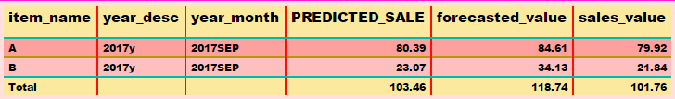
Predicted _sale is the sale for next month/quarter as per the forecasting model
Forecasted_value is the value of sale for the current month/quarter as per the forecasting model

Slide 26
Market Basket Analysis
Analysis based on Iranian case study(link attached herewith)
http://www.growingscience.com/msl/Vol5/msl_2015_21.pdf: has used the association rules to discover the hidden patterns in insurance industry
Courtesy: SAS India. Implementation at Yum Foods

Slide 27
Hypothesis
Test of the following hypothesis:
  The sale of P 96 ARM PANEL BOM(Product 1: antecedent) the probability of purchase of MEPE200515-03(Product 2; consequence) increases

Slide 28
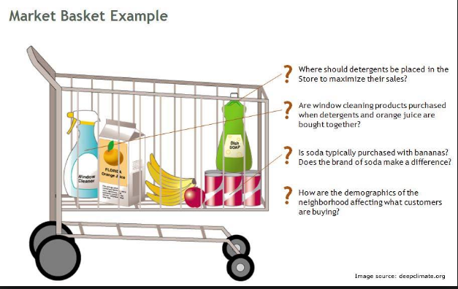
Market Basket Analysis in Retail

Slide 29
Market Basket Analysis Module
Customer segmentation based on income, type of retail product for the last 3 fiscal years: sql extract from the client master. Details fed to Turbodata
Analyze the consequence based on precedent: Turbodata
Find support, confidence, lift
Client can use k-means clustering: Excel, ‘R’, SAS, SSAS, SQL Server code, C# code
Based on the cluster parameters, the ETL team will extract the data from the required masters and transactions. Turbodata has readymade code for the same.
Turbodata has readymade code for the same

Slide 30
Sample Output Explanation
ITEMX | ITEMY | NUM_X | NUM_Y | TOTAL_ITEM | PROB_X | PROB_Y | SUPPORT | CONFIDENCE | LIFT
P 96 ARM PANEL BOM | MEPE200515-03 | 15 | 1 | 31 | 0.48387 | 0.03226 | 0.03226 | 1 | 2.06667
Support – The support for the rule indicates its impact in terms of overall size.
Confidence – It determines the operational usefulness of a rule.
Lift ratio – The lift ratio indicates how efficient in the rule is in finding consequences, compared to random selection of transaction. As a general rule, Lift ratio of greater than one suggests some usefulness in the rule.

Slide 31
Appendix-Time Series Analysis
“The Art of Forecasting”

Slide 32
Time Series Components
Trend
Cyclical
Seasonal
Irregular
Notes:
21

Slide 33
Trend Component
Persistent, overall upward or downward pattern
Due to population, technology etc.
Several years duration
Response
Mo., Qtr., Yr.
© 1984-1994 T/Maker Co.
Notes:
22

Slide 34
Trend Component
Overall Upward or Downward Movement
Data Taken Over a Period of Years
Sales
Upward trend
Time

Slide 35
Cyclical Component
Repeating up & down movements
Due to interactions of factors influencing economy
Usually 2-10 years duration
Cycle
Response
Mo., Qtr., Yr.
Notes:
23

Slide 36
Cyclical Component
Upward or Downward Swings
May Vary in Length
Usually Lasts 2 - 10 Years
Sales
Cycle
Time

Slide 37
Seasonal Component
Regular pattern of up & down fluctuations
Due to weather, customs etc.
Occurs within one year
Summer
Response
© 1984-1994 T/Maker Co.
Mo., Qtr.
Notes:
24

Slide 38
Seasonal Component
Upward or Downward Swings
Regular Patterns
Observed Within One Year
Sales
Winter
Time (Monthly or Quarterly)

Slide 39
Irregular Component
Erratic, unsystematic, ‘residual’ fluctuations
Due to random variation or unforeseen events
  Union strike
  War
Short duration &
nonrepeating
© 1984-1994 T/Maker Co.
Notes:
25

Slide 40
Random or Irregular Component
Erratic, Nonsystematic, Random, ‘Residual’ Fluctuations
Due to Random Variations of
  Nature
  Accidents
Short Duration and Non-repeating

